Slide 1


Prasad Gite
30-10-2024

Slide 2

Outline
Executive Summary
Introduction
Methodology
Results
Conclusion
Appendix

Slide 3
Executive Summary
Objective: Analyze SpaceX launch data to identify factors influencing launch success and payload efficiency.
Methodology:
Collected data via SpaceX API & web scraping.
Conducted data wrangling, EDA, and interactive visualizations with Folium and Plotly Dash.
Built classification models to predict launch success based on payload and site characteristics.
Key Insights:
Higher success rates observed at specific launch sites.
Payload size and booster type significantly impact launch outcomes.
Conclusion: Findings can guide SpaceX in optimizing launch strategies to improve mission success.

Slide 4
Introduction
Project Background and Context:
SpaceX, a leading aerospace manufacturer and space transportation company, has conducted numerous launches, each influenced by complex variables such as payload type, orbit, and launch site.
Understanding these factors is essential for optimizing launch success rates and enhancing operational efficiency.
Problems to Address:
What factors most influence successful launch outcomes?
How do payload mass and booster type impact the likelihood of launch success?
Which launch sites show the highest success rates, and what conditions contribute to this?

Slide 5

Section 1

Slide 6
Methodology
Data Collection: Retrieved launch data via SpaceX API and web scraping.
Data Wrangling: Cleaned and standardized data for consistency.
Data Processing: Consolidated features like launch site, payload, and orbit type.
EDA: Used visualizations and SQL to analyze key variables affecting success.
Interactive Analytics: Visualized launch sites with Folium maps; created a Plotly Dash dashboard for dynamic insights.
Predictive Analysis: Built and tuned classification models to forecast launch success, optimizing model accuracy.

Slide 7
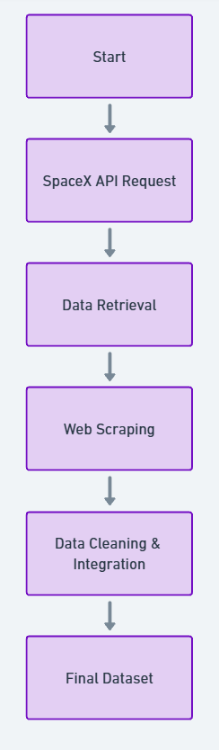
Data Collection
Data Sources:
SpaceX API: Retrieved detailed information on launch dates, payloads, launch sites, and mission outcomes.
Web Scraping: Collected supplementary data on launch site locations, booster types, and orbit details to enrich analysis.
Collection Process:
API Calls: Automated retrieval of launch data from SpaceX’s REST API, focusing on mission success metrics.
Scraping Workflow: Used Python libraries like BeautifulSoup and Requests to capture site and payload details from official SpaceX pages.
Data Integration: Merged API and web-scraped data, ensuring alignment of key variables like launch date and site name.

Slide 8
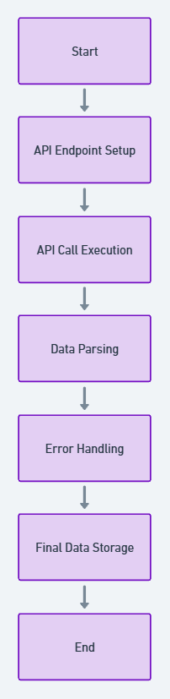
Data Collection – SpaceX API
Data Retrieval:
Utilized SpaceX’s REST API to access launch records, including key attributes like launch dates, payload details, booster types, and mission success.
Collection Process:
API Endpoint Setup: Specified endpoints to target launch and payload data.
Automated Calls: Executed API calls in Python to fetch JSON responses for each launch.
Data Parsing: Parsed JSON responses to extract relevant fields, storing them in structured formats (e.g., DataFrames).
Error Handling: Incorporated checks to handle missing values or incomplete records.
Data Integration: Combined with additional data from scraping for a comprehensive dataset.

Slide 9
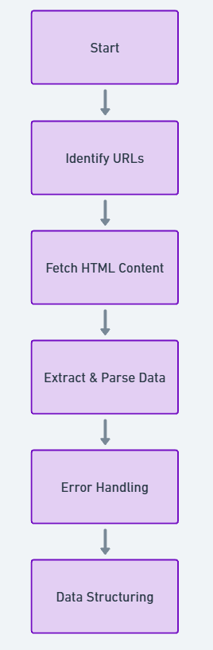
Data Collection - Scraping
Data Source:
Used official SpaceX web pages to gather supplemental data on launch sites, booster types, orbit types, and mission details not covered by the API.
Scraping Process:
URL Identification: Located target URLs for pages with relevant data on launch details.
Script Setup: Created Python scripts using BeautifulSoup and Requests to fetch HTML content.
Data Extraction: Parsed HTML to extract specific elements (e.g., tables, headers) containing necessary details.
Error Management: Implemented checks for broken links, missing data, and retries for incomplete requests.
Data Structuring: Cleaned and formatted extracted data into a structured DataFrame for analysis.

Slide 10
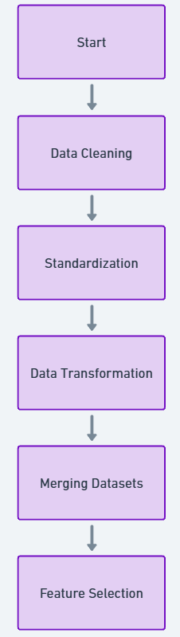
Data Wrangling
Objective:
Prepare and clean raw data for analysis by addressing inconsistencies, handling missing values, and standardizing formats.
Data Wrangling Steps:
Data Cleaning: Removed duplicates, filled missing values, and handled outliers to ensure data quality.
Standardization: Converted units (e.g., payload mass) and ensured consistent formats across columns.
Data Transformation: Created new calculated fields, such as success rate and mission duration, to support analysis.
Merging Datasets: Integrated API and scraped data based on common keys, aligning launch dates, site names, and payload information.
Feature Selection: Selected key variables for analysis, such as launch site, booster version, orbit, and payload mass.

Slide 11
EDA with Data Visualization
Charts and Purpose:
Scatter Plots:
Flight Number vs. Launch Outcome: Identified the relationship between mission experience (flight number) and success rate.
Payload Mass vs. Launch Success: Explored how payload size impacts launch success, revealing trends between mass and success rates.
Bar Charts:
Launch Site Success Rate: Compared success rates across different launch sites to identify high-performing sites.
Orbit vs. Success Rate: Analyzed the success rates for various orbits, uncovering orbit types with higher mission success.
Pie Charts:
Mission Success Distribution: Visualized the overall success-to-failure ratio to understand mission outcome proportions.
Line Charts:
Yearly Success Trend: Tracked success rates over time to observe trends and improvements in launch reliability.

Slide 12
EDA with SQL
SQL Queries and Purpose:
Total Launches by Site: Counted the number of launches per site to assess each site’s activity level.
Success Rate by Launch Site: Calculated the success rate for each site to determine site-specific reliability.
Payload Analysis by Orbit: Summarized payload mass by orbit type to see which orbits handle heavier payloads.
Mission Outcomes by Year: Counted successful and failed missions annually to identify performance trends over time.
Launch Success with Booster Versions: Analyzed success rates across different booster versions, revealing version-specific performance.

Slide 13
Build an Interactive Map with Folium
Map Objects and Purpose:
Markers: Placed markers at each launch site to visually indicate SpaceX launch locations on the map.
Colored Circles: Added color-coded circles around markers to represent launch success (green for success, red for failure), providing a quick visual reference for outcomes.
Pop-ups: Incorporated pop-ups on each marker with details like launch site name, payload mass, and orbit type to allow detailed on-click information.
Distance Lines: Drew lines from launch sites to the nearest bodies of water, highlighting geographic features related to site selection and safety considerations.

Slide 14
Build a Dashboard with Plotly Dash
Plots/Graphs and Purpose:
Pie Chart of Launch Success Rates: Displays overall success vs. failure proportions, helping users quickly understand the mission outcome distribution.
Scatter Plot of Payload Mass vs. Success by Launch Site: Allows filtering by site to analyze how payload mass influences success rates across different locations.
Bar Chart of Success Rates by Orbit Type: Compares success rates across various orbit types, highlighting which orbits have higher reliability.
Line Chart of Success Rates Over Time: Shows success trends year-over-year, useful for spotting improvements in reliability.
Interactive Features:
Dropdown Filters: Enables selection by launch site, orbit type, or year, allowing users to view detailed insights for specific categories.
Hover and Zoom Interactivity: Provides data tooltips on hover and zooming options for a deeper dive into specific data points.

Slide 15
Predictive Analysis (Classification)
Model Development Process:
Model Selection: Chose multiple classifiers, including Logistic Regression, Decision Tree, and Random Forest, to identify the best fit for predicting launch success.
Training and Evaluation: Trained each model on historical launch data and evaluated them using metrics like accuracy, precision, and recall.
Hyperparameter Tuning: Performed grid search and cross-validation to optimize parameters, improving model performance.
Model Comparison: Compared models based on evaluation metrics to identify the most accurate and robust model.
Best Performing Model: Selected the Random Forest model for its high accuracy and balanced precision-recall scores.

Slide 16
Results
Exploratory Data Analysis Results
Key Findings:
Launch Success Rates: Identified that specific launch sites, such as Cape Canaveral, have higher success rates compared to others.
Payload Impact: Found that payload mass has a significant influence on launch success, with heavier payloads showing lower success rates in certain orbit types.
Trend Analysis: Observed a positive trend in success rates over the years, indicating improvements in launch technology and operations.
Interactive Analytics Demo:
Screenshots: Include screenshots of the interactive dashboard demonstrating:
Launch Success Pie Chart
Payload Mass vs. Success Scatter Plot
Success Rate by Orbit Bar Chart
Success Rates Over Time Line Chart

Slide 17

Section 2

Slide 18
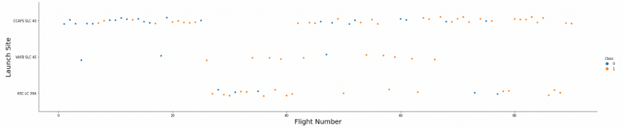
Flight Number vs. Launch Site
The earliest flights all failed while the latest flights all succeeded.
The CCAFS SLC 40 launch site has about a half of all launches.
VAFB SLC 4E and KSC LC 39A have higher success rates.
It can be assumed that each new launch has a higher rate of success

Slide 19
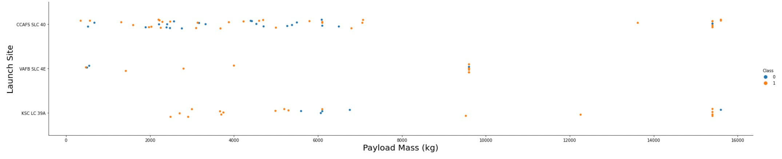
Payload vs. Launch Site
For every launch site the higher the payload mass, the higher the success rate.
Most of the launches with payload mass over 7000 kg were successful.
KSC LC 39A has a 100% success rate for payload mass under 5500 kg too

Slide 20
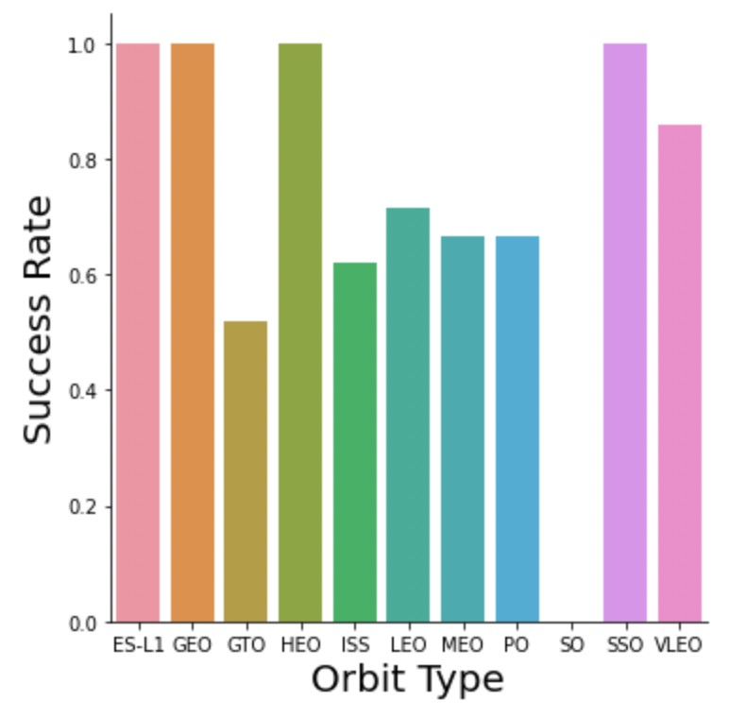
Success Rate vs. Orbit Type
Orbits with 100% success rate: ES-L1, GEO, HEO, SSO
Orbits with 0% success rate: SO
Orbits with success rate between 50% and 85%: GTO, ISS, LEO, MEO, PO

Slide 21
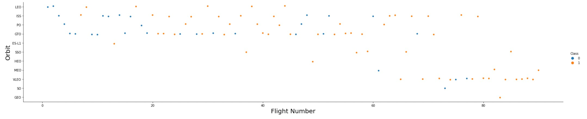
Flight Number vs. Orbit Type
In the LEO orbit the Success appears related to the number of flights; on the other hand, there seems to be no relationship between flight number when in GTO orbit.

Slide 22
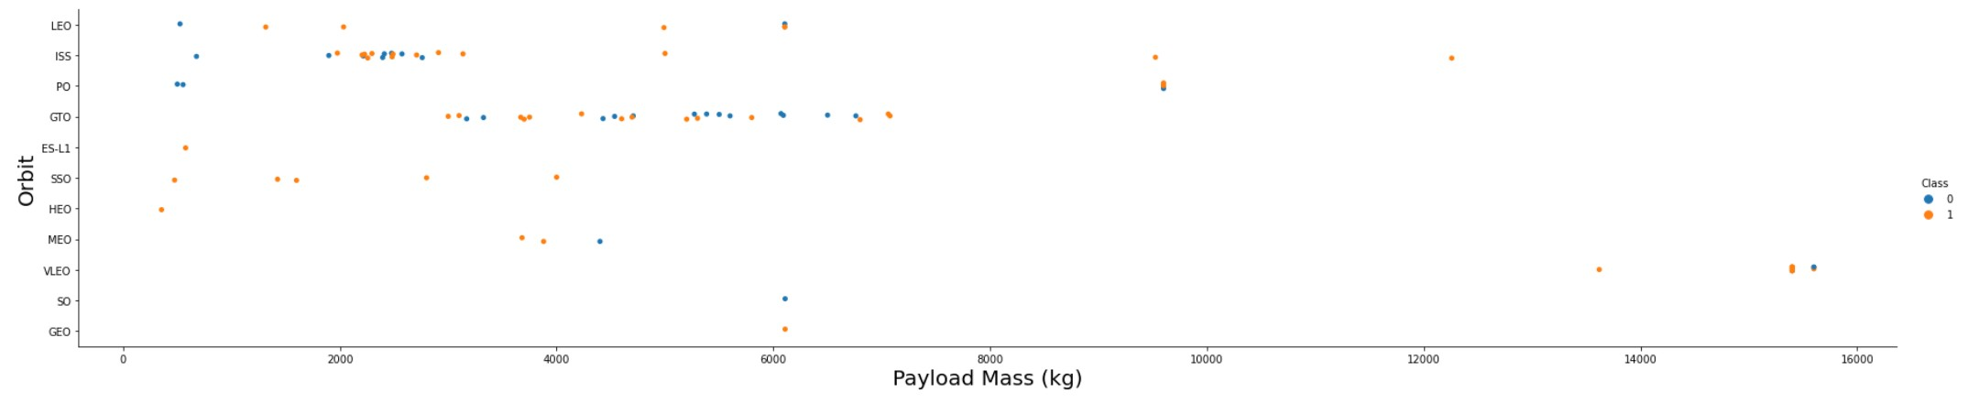
Payload vs. Orbit Type
Heavy payloads have a negative influence on GTO orbits and positive on GTO and Polar LEO (ISS) orbits.

Slide 23
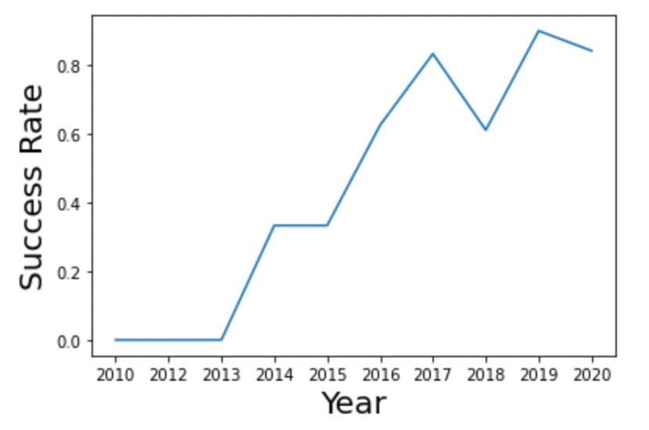
Launch Success Yearly Trend
The success rate since 2013 kept increasing till 2020.

Slide 24
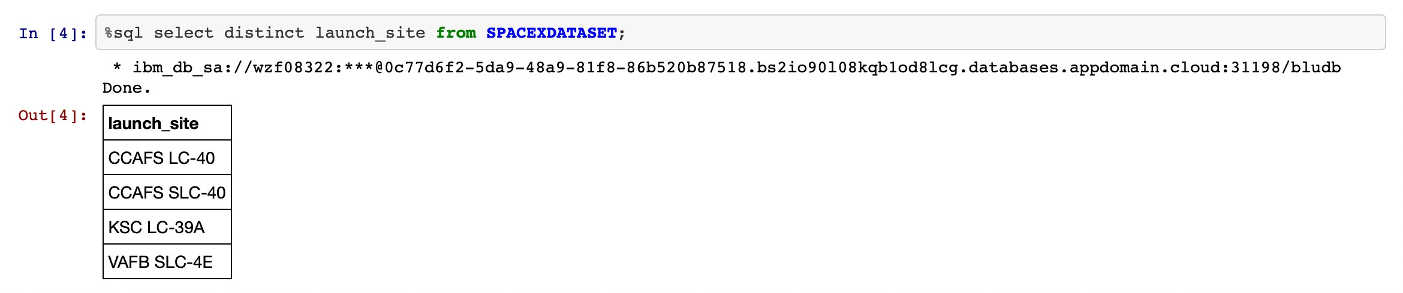
All Launch Site Names
Find the names of the unique launch sites
Present your query result with a short explanation here

Slide 25
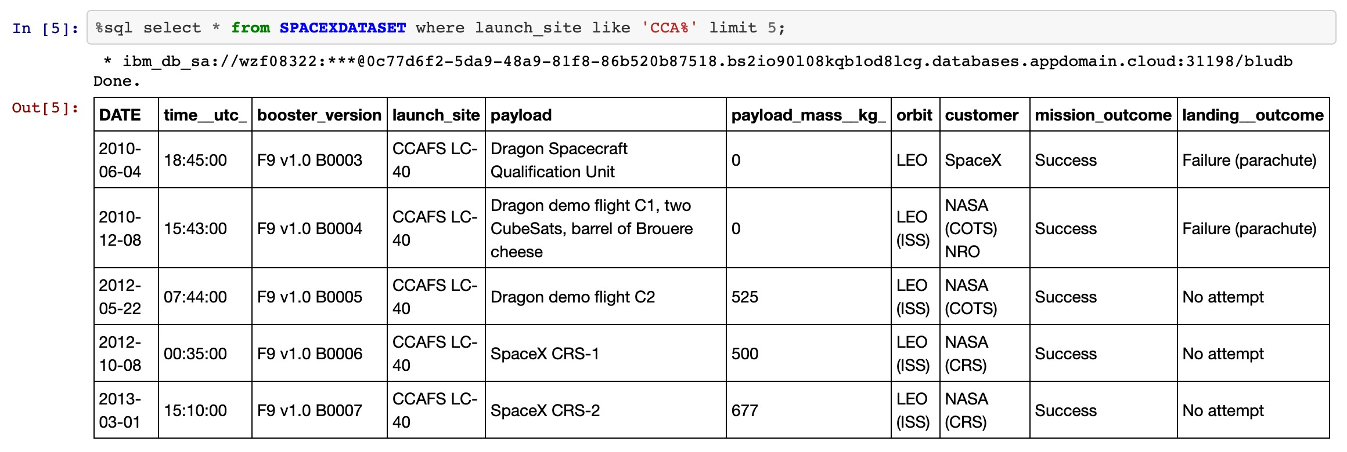
Launch Site Names Begin with 'CCA'
Find 5 records where launch sites begin with `CCA`
Present your query result with a short explanation here
Displaying 5 records where launch sites begin with the string 'CCA'.

Slide 26
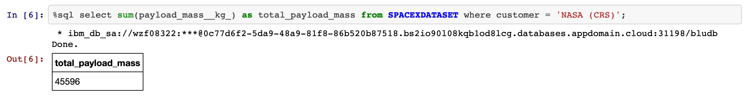
Total Payload Mass
Calculate the total payload carried by boosters from NASA
Present your query result with a short explanation here
Explanation:
Displaying the total payload mass carried by boosters launched by NASA (CRS).

Slide 27
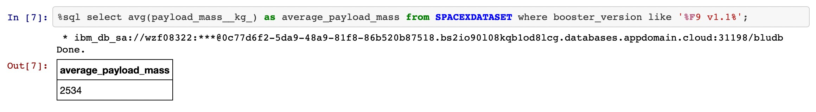
Average Payload Mass by F9 v1.1
Calculate the average payload mass carried by booster version F9 v1.1
Present your query result with a short explanation here

Slide 28
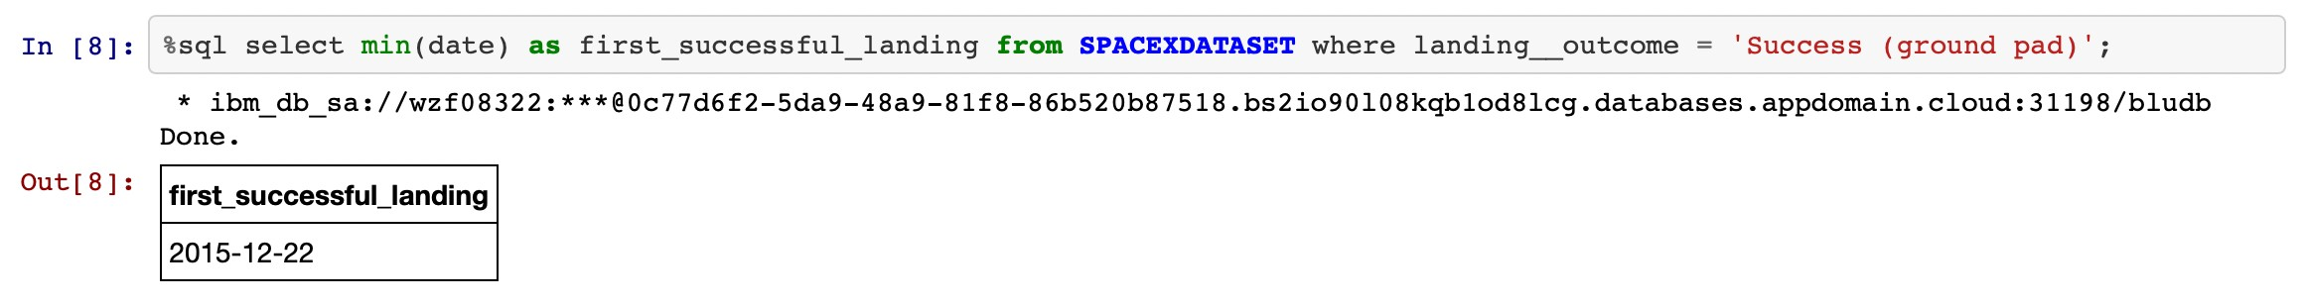
First Successful Ground Landing Date

Slide 29
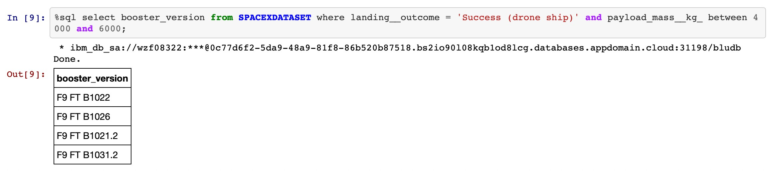
Successful Drone Ship Landing with Payload between 4000 and 6000
Explanation:
Listing the names of the boosters which have success in drone ship and have payload mass greater than 4000 but less than 6000.

Slide 30
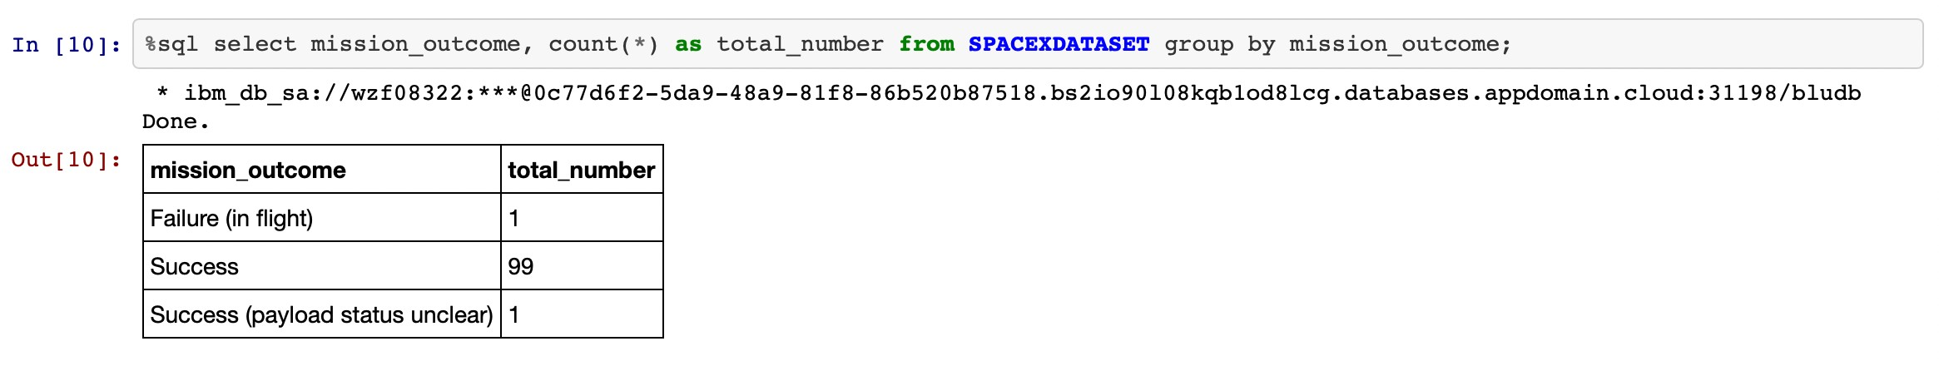
Total Number of Successful and Failure Mission Outcomes
Listing the total number of successful and failure mission outcomes.

Slide 31
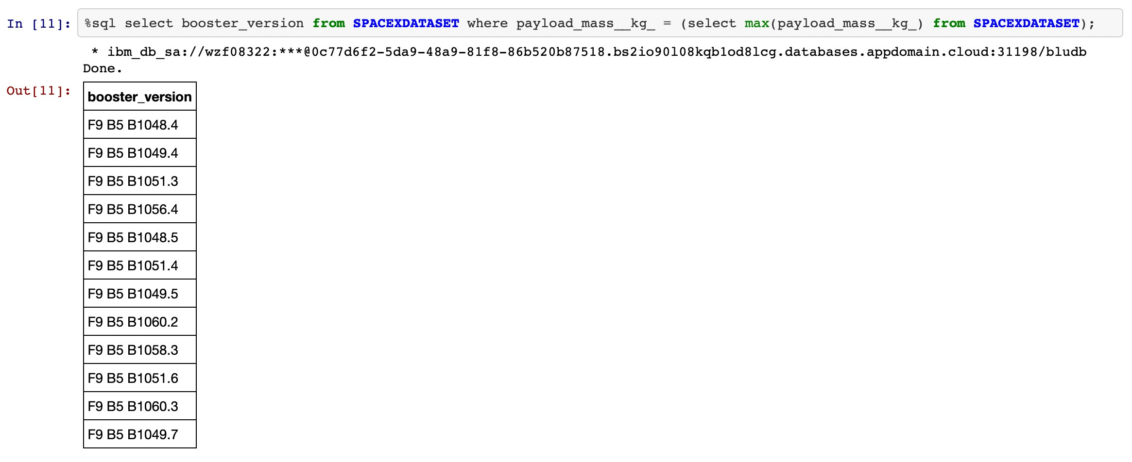
Boosters Carried Maximum Payload

Slide 32
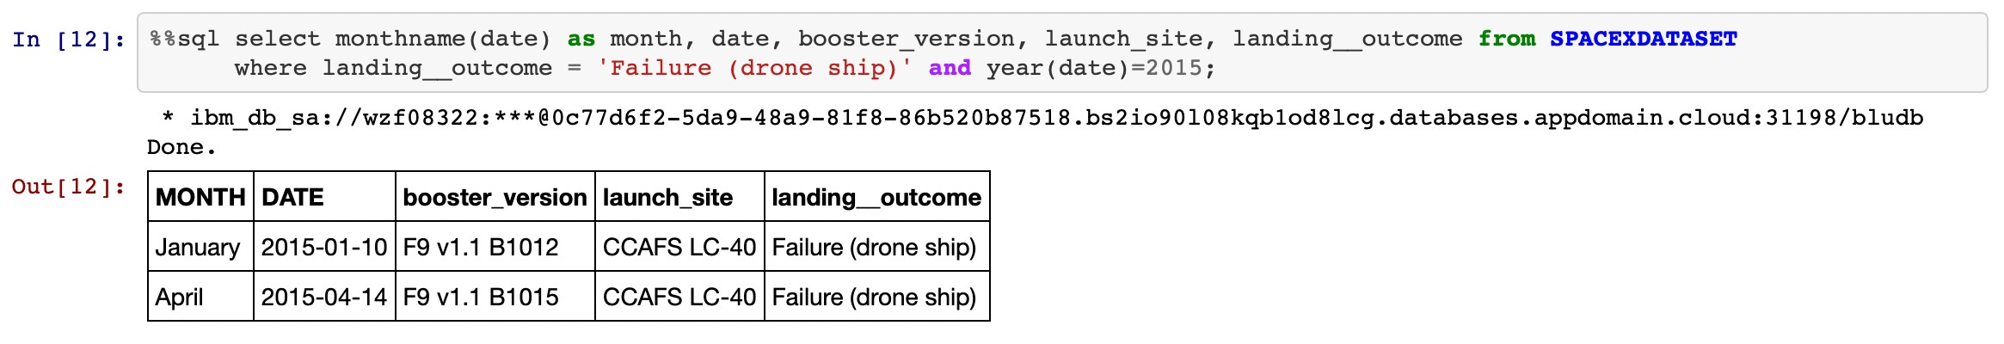
2015 Launch Records

Slide 33
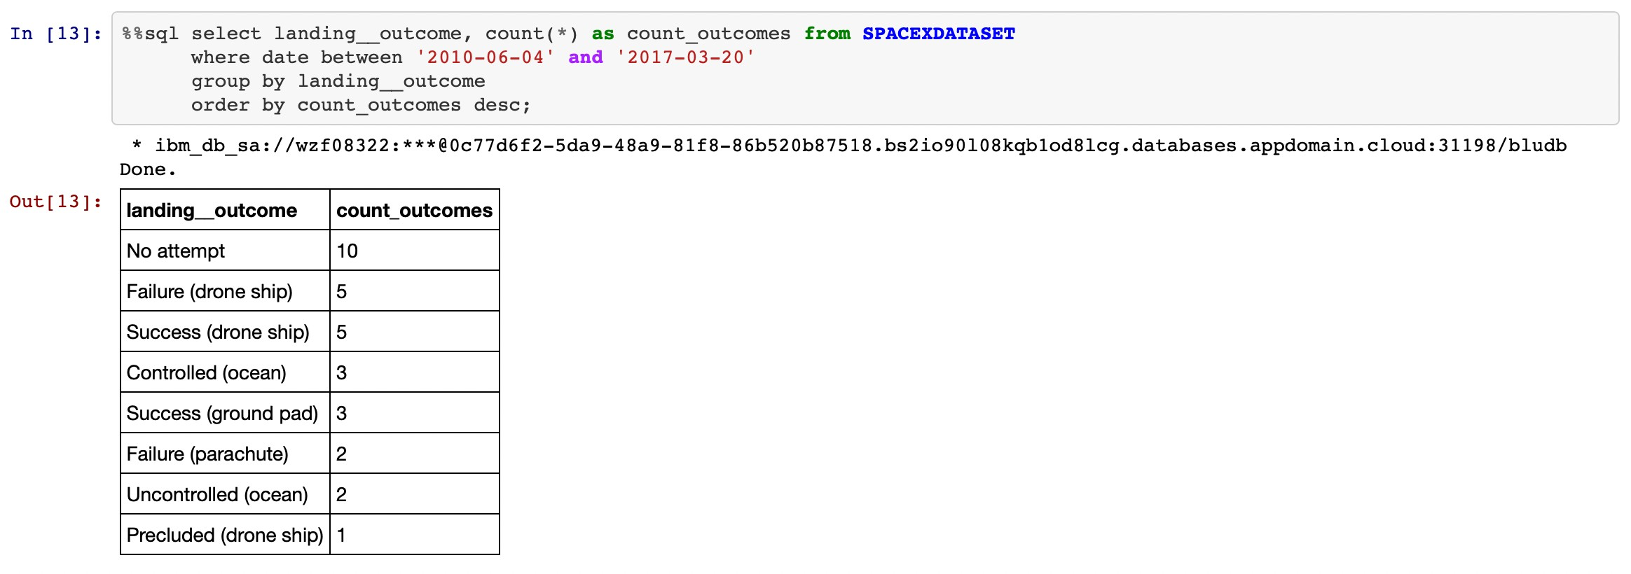
Rank Landing Outcomes Between 2010-06-04 and 2017-03-20
Listing the failed landing outcomes in drone ship, their booster versions and launch site names for the months in year 2015.

Slide 34

Section 3

Slide 35
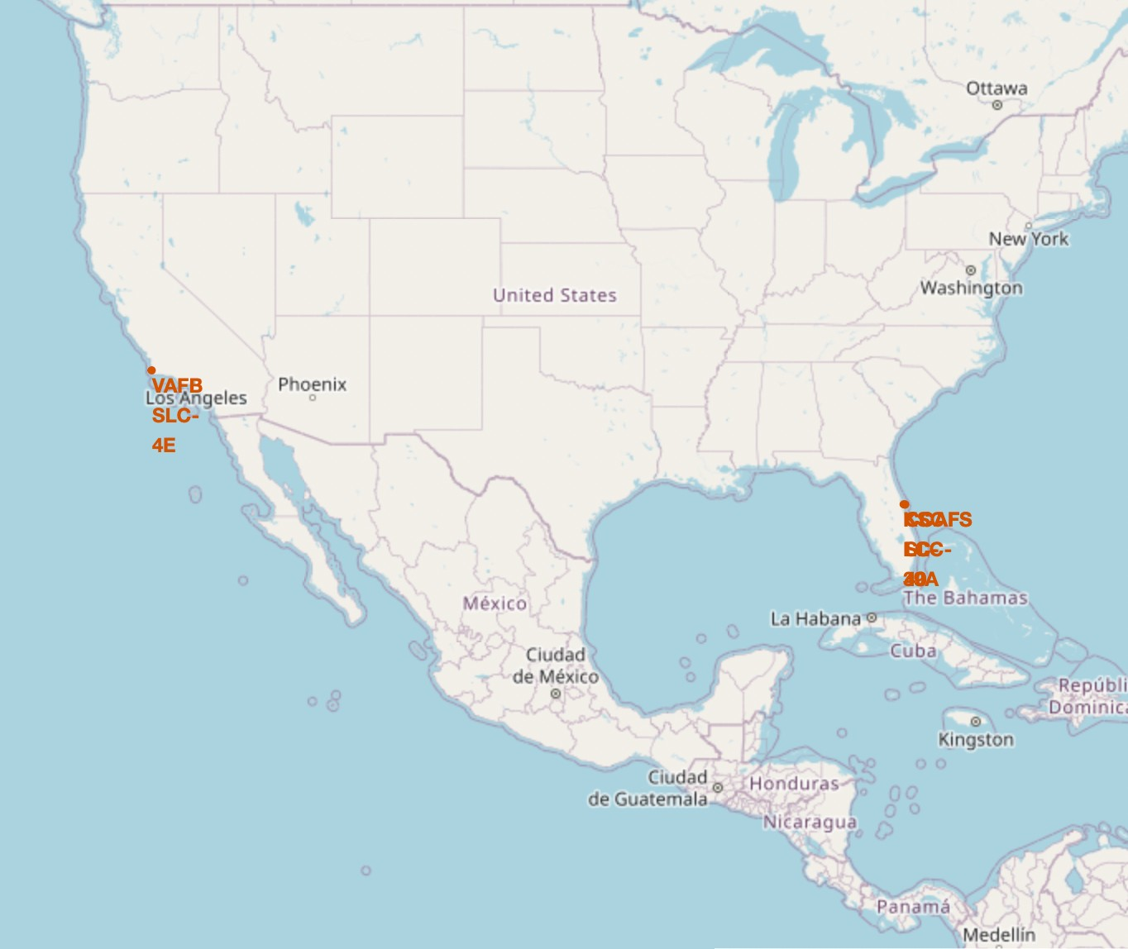
All launch Sites location markers in a Global map
Explanation:
Most of Launch sites are in proximity to the Equator line. The land is moving faster at the equator than any other place on the surface of the Earth. Anything on the surface of the Earth at the equator is already moving at 1670 km/hour. If a ship is launched from the equator it goes up into space, and it is also moving around the Earth at the same speed it was moving before launching. This is because of inertia. This speed will help the spacecraft keep up a good enough speed to stay in orbit.
All launch sites are in very close proximity to the coast, while launching rockets towards the ocean it minimises the risk of having any debris dropping or exploding near people.

Slide 36
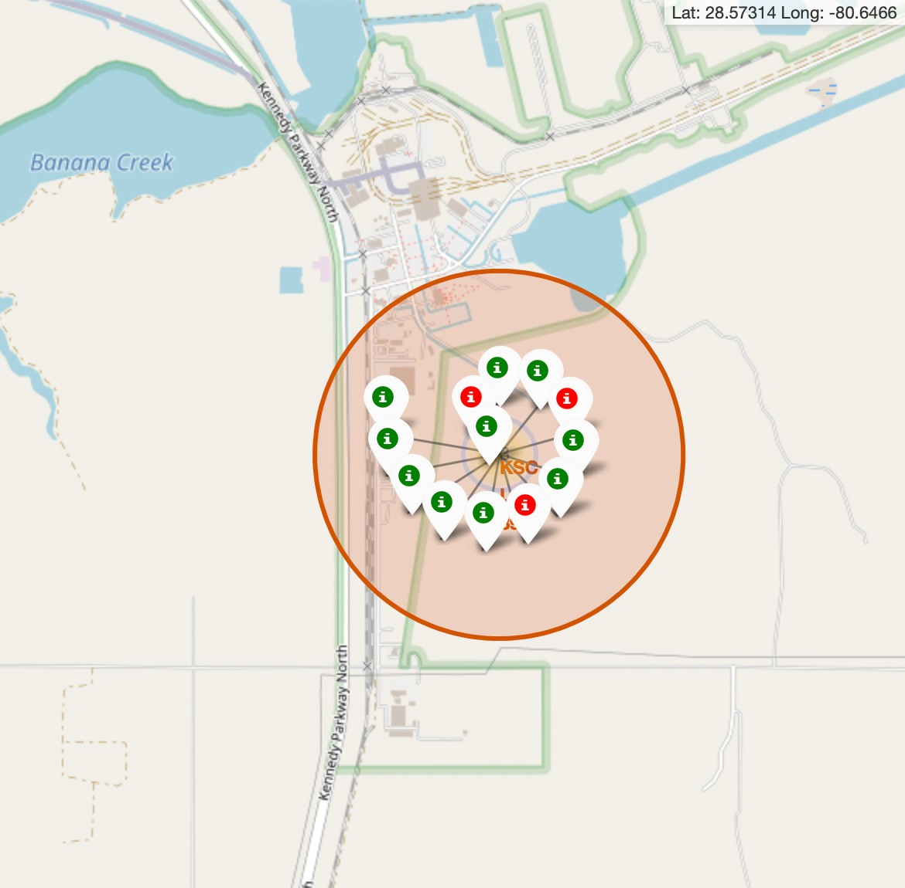
Explanation:
Colour-Labeled launch records on the map
From the colour-labeled markers we should be able to easily identify which launch sites have relatively high success rates.
Green Marker = Successful Launch
Red Marker = Failed Launch
Launch Site KSC LC-39A has a very high Success Rate.

Slide 37
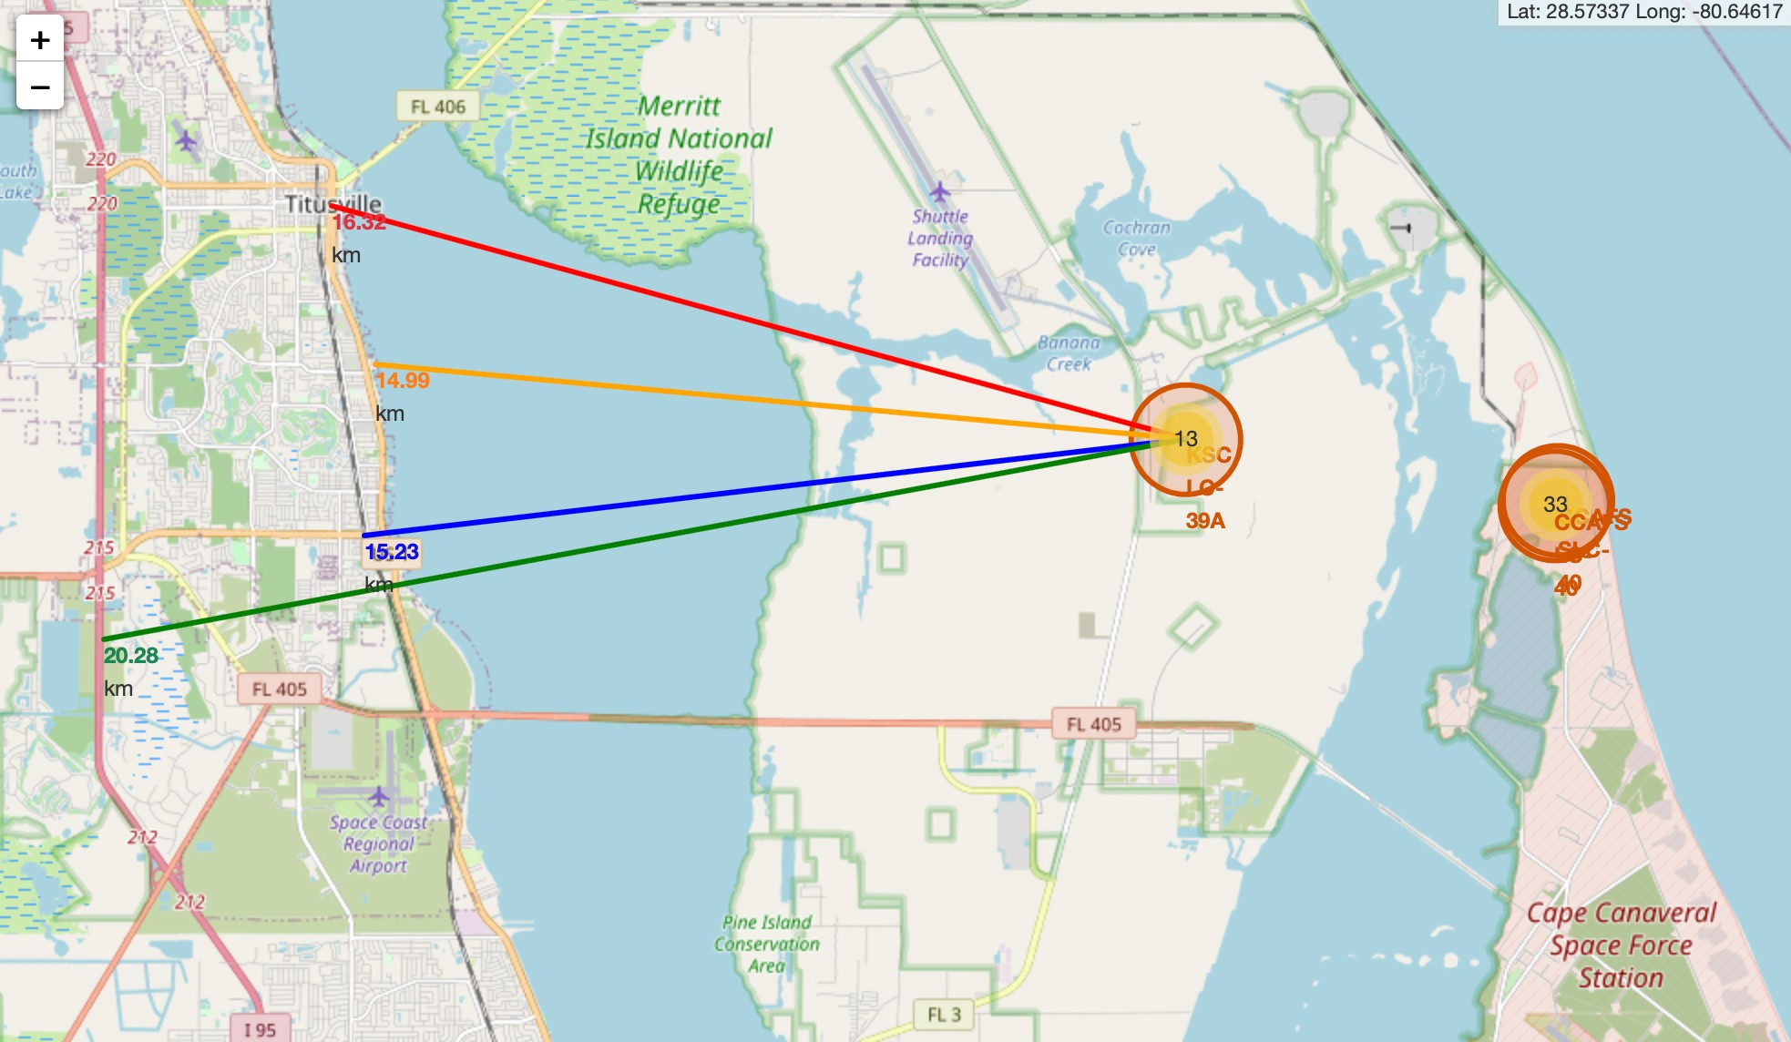
Distance from the launch site KSC LC-39A to its proximites
Explanation:
From the visual analysis of the launch site KSC LC-39A we can clearly see that it is:
relative close to railway (15.23 km)
relative close to highway (20.28 km)
relative close to coastline (14.99 km)
Also the launch site KSC LC-39A is relative close to its closest city Titusville (16.32 km).
Failed rocket with its high speed can cover distances like 15-20 km in few seconds. It could be potentially dangerous to populated areas.

Slide 38

Section 4

Slide 39
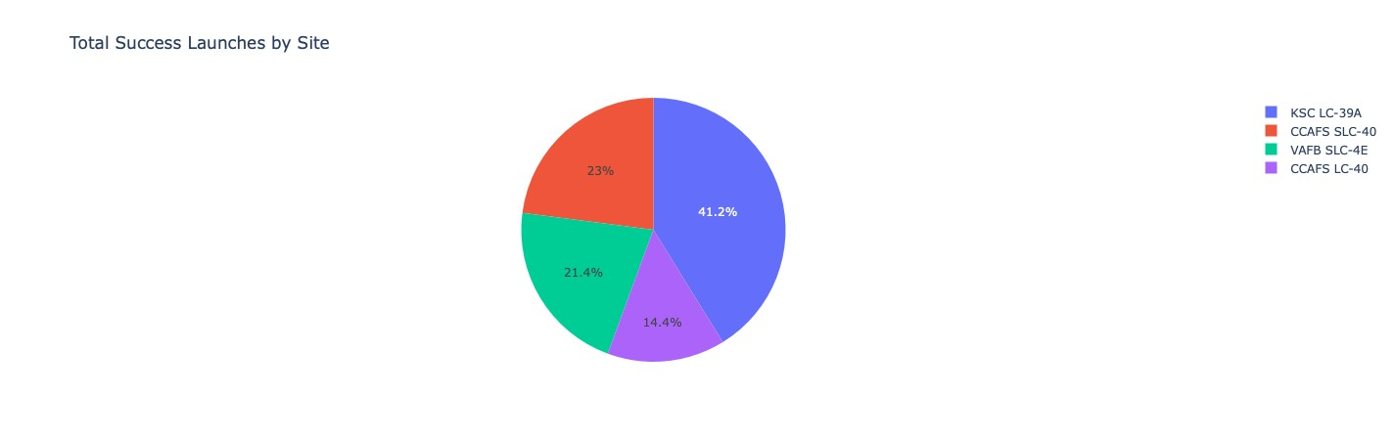
Launch success count for all Sites
Explanation:
The chart clearly shows that from all the sites, KSC LC-39A has the most successful launches.

Slide 40
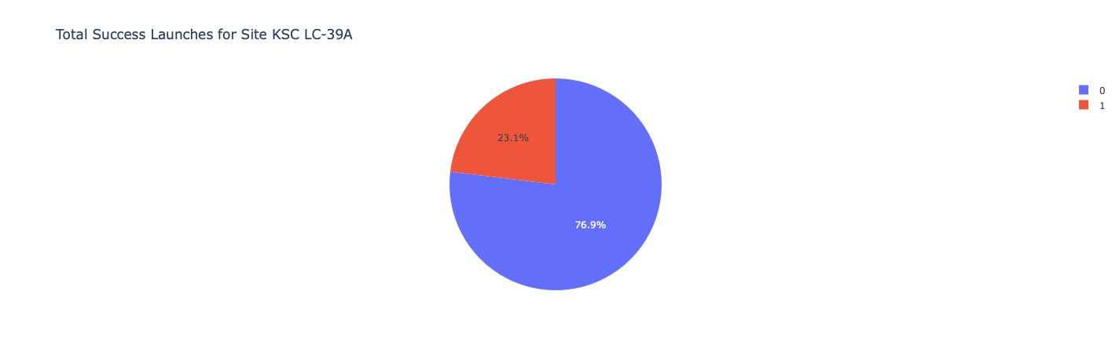
Launch sites with highest success ratio
Explanation:
KSC LC-39A has the highest launch success rate (76.9%) with 10 successful and only 3 failed landings.

Slide 41
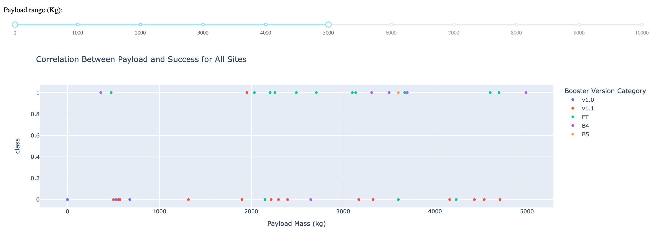
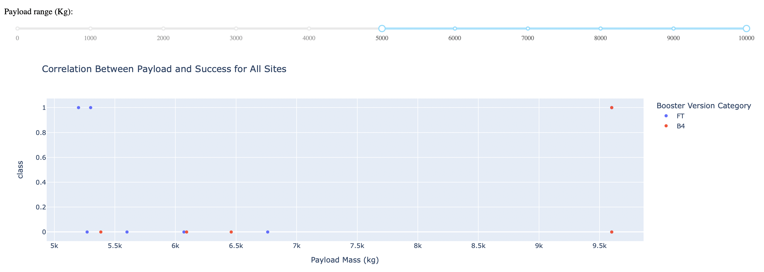
Payload Mass vs. Launch Outcomes for all sites
The charts show that payloads between 2000 and 5500 kg have the highest success rate.

Slide 42

Section 5

Slide 43
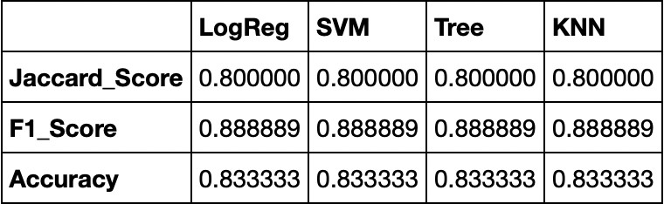
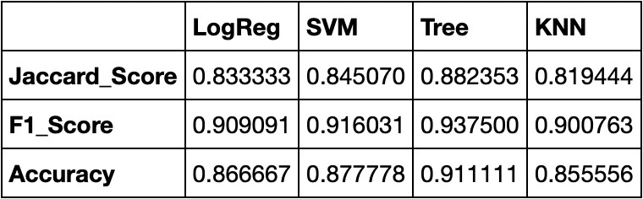
Scores and Accuracy of the Test Set
Classification Accuracy
Explanation:
Based on the scores of the Test Set, we can not confirm which method performs best.
Same Test Set scores may be due to the small test sample size (18 samples). Therefore, we tested all methods based on the whole Dataset.
The scores of the whole Dataset confirm that the best model is the Decision Tree Model. This model has not only higher scores, but also the highest accuracy.
Scores and Accuracy of the Entire Data Set

Slide 44
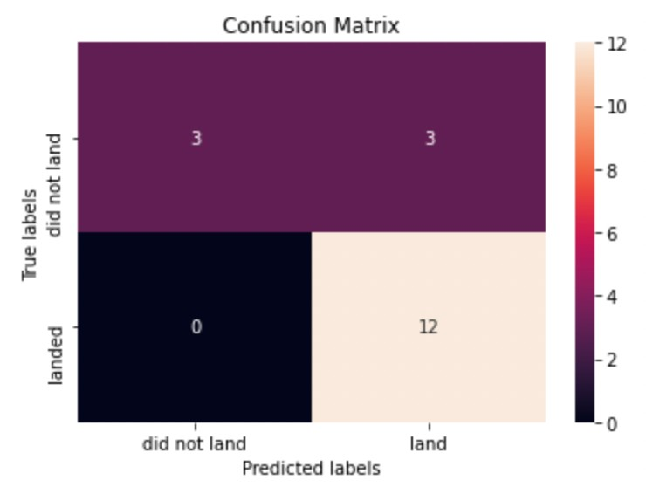
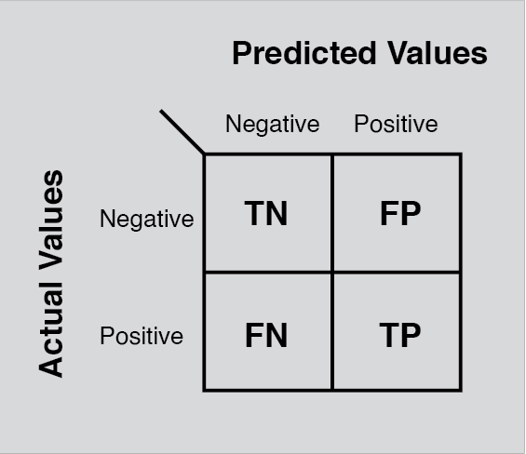
Explanation:
Confusion Matrix
Examining the confusion matrix, we see that logistic regression can distinguish between the different classes. We see that the major problem is false positives.

Slide 45

Conclusion
Decision Tree Model is the best algorithm for this dataset.
Launches with a low payload mass show better results than launches with a larger payload mass.
Most of launch sites are in proximity to the Equator line and all the sites are in very close proximity to the coast.
The success rate of launches increases over the years.
KSC LC-39A has the highest success rate of the launches from all the sites.
Orbits ES-L1, GEO, HEO and SSO have 100% success rate.

Slide 46


